Slide 1
LinkedIn scraper
Project Scope Definition & Alignment

Slide 2
Today’s goals
To do
Afbakening Use Case 1
Agenda
UC1 scope
Huidige status

Slide 3
UC1 scope
Mock-ups

Slide 4
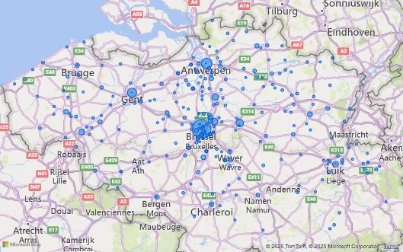
Page 1: Overview Page
#Postings in last 30 Days
#Companies who have a posting in the last 30d
Last ingested_at (update Time)
Skills (Top 10) | Occurences
Skill x | 365
Skill Y | 265
Companies (Top 5) | # Postings (last 30 days)
Company A | 12
Company B | 10

Slide 5
Page 2: inserted Postings of today
Filter on this page ingested_at in last 1 day
Posting title | Company | City A | Posting Date
Posting A | Company A | City A | 13/10/2025
Posting B | Company B | City B | 1/10/2025
Drill through mogelijkheid op posting

Slide 6
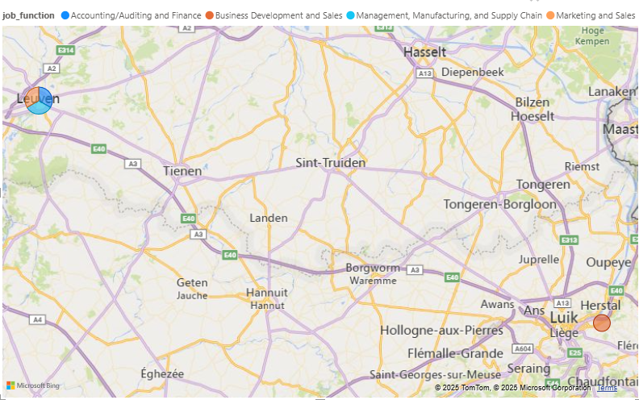
Page 3: Company Page
Company Filter
Posting Title Filter
Posting title | Job_Type | Job_level | Posting Date
Posting A | A | Entry | 13/10/2025
2 | B | Mid-senior | 1/10/2025

Slide 7
Page 4: Posting Drillthrough Page
Posting Title: …………………… & Company: ……..
Posting Date
Skill | Skill Level
Skill A | Level …
Skill B | Level …
Language
Fluent in French
Contact Person | Contact info
Ad Adam | +32 XXX XXX XXX ad.adam@adam.com
Posting Description
S…………………

Slide 8
Page 6: Skills Page
Skill Filter
Bar chart dat toont hoe vaak een skill voorkomt per Indusry & per departement
Posting per Industry (Pie Chart)

Slide 9
Page 7: Skill – Company Page
Company Filter
Skill Filter
Company | Skill | Skill Count
Company A | Python | 15
Company B | SQL | 3

Slide 10
Requirements
Code Sander
…

Slide 11
Huidige situatie

Slide 12
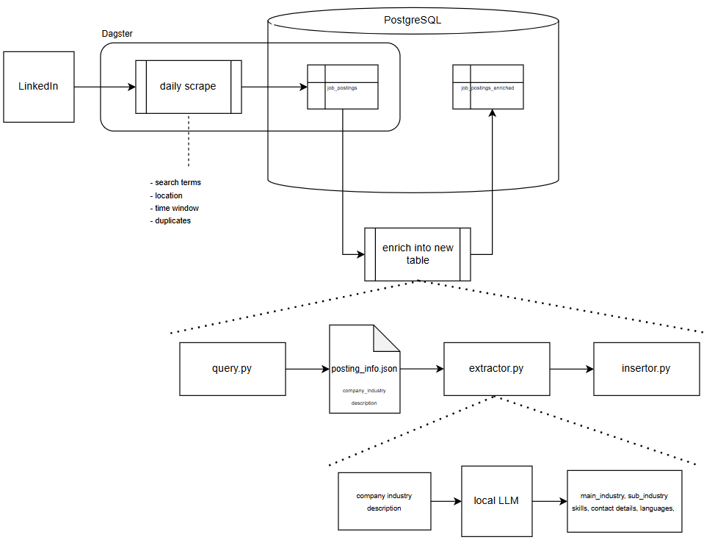
90%
100%
0%
75%
90%
70%
90%
70%

Slide 13
Timeline & Milestones
Datum | Deliverable | Beschrijving
14 okt | Draft requirements document | Lijst afronden en laten valideren
14 okt | Scope meeting | Definitieve afbakening van Use Case 1
18 okt | Datacleaning regels & synoniemenlijst klaar | Voor tests en filtering
23 okt – 2 nov | 🏖️ Afwezigheid Thibault (Front end developer) | In deze periode: LLM fine-tuning
30 okt | LLM klaar | LLM werkt volgens requirements
7 nov | Eerste versie Skill dashboard | Basislogica werkend na verlof
10 nov | Review + refinements | Feedbackronde met team
15 nov (zaterdag?) | Final delivery Use Case 1 | Gereed voor presentatie/demo

Slide 14
Next Steps
LLM finetuning
…

